Slide 1
UNIVERSAL DISCLOSURE PROTOCOL FOR MEDIATION (UDPM)
Alliance of mediators for Universal Disclosure
Helping make mediation mainstream
Notes:
Dear dispute resolvers and other colleagues,
Thank you for being here listening about this topic today.
I am going to speak about the Universal Disclosure Protocol for Mediation (UDPM). I believe that this protocol will help make mediation mainstream and I hope that at the end of this presentation you know why and you know how yourself can be part of this movement.

Slide 2
What is the UDPM?
6 elements to disclose at the start of any mediation . . .
Conflict of interest
Confidentiality
General process
Role of the mediator and parties
Technology
Impact of venue
. . . delivering a global message to parties regarding what they can expect from Mediation, whatever their cultural, religious, legal, or national context.
www.udpm.org
Notes:
UDPM states for Universal Disclosure Protocol for Mediation and is a list of a minimum of 6 elements to disclose at the start of any mediation
Conflict of interest
Confidentiality
General process
Role of the mediator and parties
Technology
Impact of venue
delivering a global message to parties regarding what they can expect from Mediation, whatever their cultural, religious, legal, or national context.
In its early period the use of mediation as an alternative to court decisions was unregulated. The practice of mediation was nascent, and the sparse use of mediation created little need for regulation. As Jay Folberg, Professor Emeritus and former Dean at the University of San Francisco School of Law and JAMS professional, wrote –“The absence of regulation allowed a ‘thousand flowers to bloom’” The variety of unregulated mediation practices and providers created confusion over what mediation is, as well as concerns about the quality of services, procedural fairness, how mediation was being sold and its impact on court proceedings.
Note: Jay Folberg former Dean and professor emeritus at the university of San Francisco School of law. Executive Director of JAMS institute

Slide 3
Why do we need a Universal Protocol for Disclosure in Mediation (UDPM)?
To make mediation mainstream worldwide – to ensure adequate self-determination
www.udpm.org
Notes:
Why do we need a Universal Protocol for Disclosure in Mediation (UDPM)?
We need an UDPM to Make mediation mainstream worldwide and to ensure self determination
And I am going to explain you how in the next slides

Slide 4
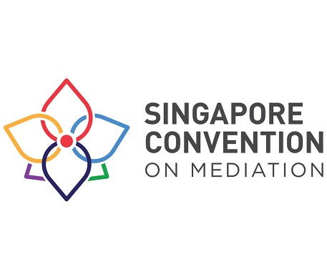
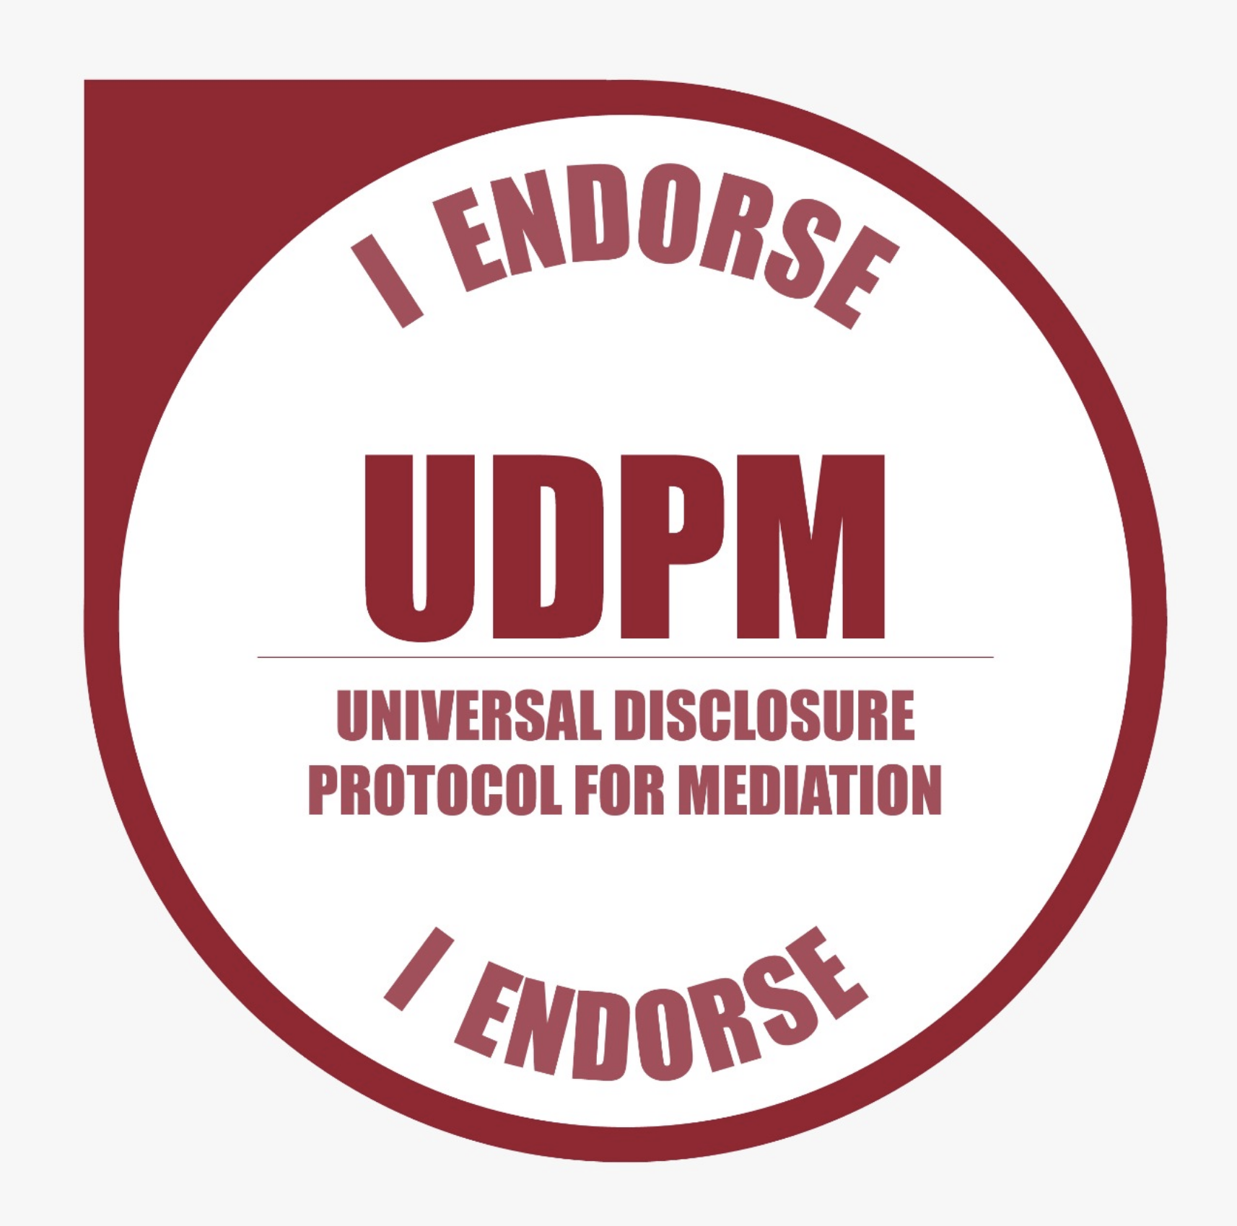
Why is mediation not mainstream today?
Perceived lack of enforceability
Lack of consistency of mediation practice
Lack of information about what to expect from the mediator
www.udpm.org
Notes:
Let s start by questioning the reasons Why mediation is not mainstream today.
The lack of enforcement of settlement agreements has been for long time an argument why mediation has not developed as other institutes. Often studies compared arbitration and mediation and attributed the main reason for the development of arbitration in the last decades to the existence of the New York Arbitration Convention that in 1958
applies to the recognition and enforcement of foreign arbitral awards and the referral by a court to arbitration. With the Singapore Convention on mediation, known as the Singapore Convention, mediation gets an uniform and efficient framework for international settlement agreements resulting from mediation enabling disputing parties to easily enforce and invoke settlement agreements across borders. On October 13th 2021, 55 countries signed the convention and 7 have already ratified it. So this first argument is going with the Singapore convention to be solved
The lack of consistency of mediation practice
– this is in our opinion the second reason why mediation is not mainstream today. Mediation today offers a KALEIDOSCOPIC landscape with huge varieties, and there is no “common cores” or practices that are universally applied around the world. As Manon Schonewille and Jeremy Lack concluded after a survey of more than 60 states around the world in the forewords of a book called The variegated landscape of mediation: A Comparative Study of Mediation Regulation and Practices in Europe and the World, I quote : “It is difficult to extract any clear standards or processes for mediation when 2 parties come from different jurisdictions, especially when the expectations, styles and approaches to mediation vary greatly from country to country”
The lack of information about what to expect from the mediator
– this is also today in our opinion a big obstacle to mediation to become mainstream worldwide. We believe that UDPM ensures that parties are informed, and informed parties mean informed choices; preserves the trust in the relationship between the mediator and the parties and respective counsels, and last but not least shows respect of the party’s needs.

Slide 5
How is the UDPM making mediation mainstream worldwide?
By giving certainty to future parties considering mediation
Clients know what they are getting, and what they can expect from the mediator and the mediation process.
By respecting the extreme diversity of mediation applications and approaches across the world.
The Protocol is not intended to advantage or disadvantage any particular mediation style or approach - it respects the diversity of practice that exists across the world.
By supporting self-determination of parties entering the mediation process
The right and ability of the parties in mediation to freely and with understanding engage in the mediation process, is a nearly universal principle in mediation.
www.udpm.org
Notes:
How is the UDPM making mediation mainstream worldwide ?
Several reasons to answer this question.
By giving certainty to future parties considering mediation
Clients know what they are getting, and what they can expect from the mediator and the mediation process.
The different stakeholder of mediation need to be able to do a risk assessment so they can do the correct choice for the process to use to solve the dispute. In order to do this they need to understand the process and the role of the mediator, and this will make them at least consider this option of going to mediation.
By respecting the extreme diversity of mediation applications and approaches across the world.
By respecting the flexibility of the mediation process
Mediators can continue to offer what they usually do.
The Protocol is not intended to advantage or disadvantage any particular mediation style or approach - it respects the diversity of practice that exists across the world.
You don’t have flexibility in court – you need to follow the process, you have few flexibility in arbitration – you need to follow institutional rules, we have flexibility in mediation and it is the only dispute resolution mechanism where the participants can also help to define the process itself. And UDPM allow that and promote the discussion of this important topic.
By supporting self-determination of parties entering the mediation process
The right and ability of the parties in mediation to freely and with understanding engage in the mediation process, is a nearly universal principle in mediation.
Clients and lawyers know what is going to happen and agree with that
There are, across cultures and legal jurisdictions, a broad range of mediation styles and “norms.” The concept of self-determination, the right and ability of the parties in mediation to freely and with understanding engage in the mediation process, is as close to a universal principle in mediation as can be found. Encouraging and supporting true self-determination is central to fair and effective mediation.

Slide 6
How is the UDPM making mediation mainstream worldwide?
By acknowledging cultural influences
A Disclosure Protocol will not remove the influence of culture from mediation. It will inform parties of the potential for cultural nuances, and it will give them a chance to either accept or reject those cultural influences.
By promoting transparency
Use of the Protocol will present a transparent description of the mediator’s process ensures that cultural, regional, and practice differences are clearly presented.
By offering a simple framework to start any mediation in any venue
All the stakeholders and the mediator understand the structure and process
www.udpm.org
Notes:
And to continue on How is the UDPM making mediation mainstream we can also add that is by
By acknowledging cultural influences
A Disclosure Protocol will not remove the influence of culture from mediation. It will inform parties of the potential for cultural nuances, and it will give them a chance to either accept or reject those cultural influences.
Existence of a Disclosure Protocol will not, in and of itself, remove the influence of cultural bias from cross-cultural mediation. It will, however, inform parties of the potential for cultural nuances affecting the mediator’s process, and it will give them a chance to either accept or reject those cultural influences as part of their mediation experience.
By promoting transparency
Use of the Protocol will present a transparent description of the mediator’s process ensures that cultural, regional, and practice differences are clearly presented.
By offering a simple framework to start any mediation in any venue
All the stakeholders and the mediator understand the structure and process.

Slide 7
What the UDPM is not
An attempt to ”standardize” mediation
It is a list of elements for discussion and understanding - the substance of each element is up to the mediator to define and present.
A set of rules
It is, rather, guidance regarding best practices for informing the parties regarding the mediator’s process and approach and documenting the exercise of self-determination.
A one way process
Communication from the mediator should be the result of a set of exchanges between the mediator and the parties, with agreement on process accepted by all.
www.udpm.org
Notes:
The main fear that we felt during all these years discussing about this topic was the fear that trying to impose something to all the mediators around the world will kill the sole of mediation. And because of this we feel the need to explain what UDPM is not so we are clear about our intentions when we ask you to come and be part of the Alliance Alliance of Mediators for Universal Disclosure.
UDPM is not
An attempt to ”standardize” mediation
It is a list of elements for discussion and understanding - the substance of each element is up to the mediator to define and present.
UDPM is not
A set of rules
It is, rather, guidance regarding best practices for informing the parties regarding the mediator’s process and approach and documenting the exercise of self-determination.
UDPM is not
A one way process
Communication from the mediator should be the result of a set of exchanges between the mediator and the parties, with agreement on process accepted by all.

Slide 8
How was UDPM initiated?
The initiators
Ana Maria Maia Gonçalves and Daniel Rainey
The working groups
Europe
Africa
Asia
MENA
Latin America
North America
Australia
www.udpm.org
Notes:
So we explained what the UDPM, we discussed the reasons why we think mediation is not mainstream today, and we discussed how UDPM will help making mediation mainstream worldwide. We are now looking at how we manage to arrive here at this stage of the UDPM.
How was UDPM initiated?
Ana Maria Maia Gonçalves and Daniel Rainey, are the initiators of UDPM and have coordinated the development of the UDPM with mediators from Europe, Africa, Australia, Latin America, North America, and Asia. François Bogacz has greatly contributed to the development of the UDPM and has been a co-writer of most publications.
During 2020 and 2021 these working groups have had several meetings per region
Europe
Africa
Asia
MENA
Latin America
North America
Australia
And we compiled all the information and define the website that exists today

Slide 9
Points of consensus of the international UDPM working groups
Mediation needs this global initiative
Guidance for mediators regarding what to address with parties, particularly in instances where mediation occurs in a cross-border or multi-cultural environment, is a valuable resource.
It is useful for the parties to understand what mediation is and is not
Use of the UDPM would reduce uncertainty, and would take into account nationality, legal setting, culture, and mediator preference.
It does not kill the flexibility of mediation
A UDPM should respect and take into account the variegated nature of mediation around the world.
www.udpm.org
Notes:
What are the Points of consensus of the international UDPM working groups?
Mediation needs this global initiative
Guidance for mediators regarding what to address with parties, particularly in instances where mediation occurs in a cross-border or multi-cultural environment, is a valuable resource.
It is useful for the parties to understand what mediation is and is not
Use of the UDPM would reduce uncertainty, and would take into account nationality, legal setting, culture, and mediator preference.
It does not kill the flexibility of mediation
A UDPM should respect and take into account the variegated nature of mediation around the world.

Slide 10
Points of consensus of the international UDPM working groups
It is to be used at the start of and during the mediation
To be maximally useful, the UDPM should address both information available to the parties in the intake phase of mediation, and as the mediator and parties begin to address the issues at hand in the mediation.
Keep it simple and short
To be practically useful, the UDPM should be simple, with a minimum number of “required” points, bolstered by examples and alternatives.
www.udpm.org
Notes:
Points of consensus of the international UDPM working groups
It is to be used at the start of and during the mediation
To be maximally useful, the UDPM should address both information available to the parties in the intake phase of mediation, and as the mediator and parties begin to address the issues at hand in the mediation.
Keep it simple and short
To be practically useful, the UDPM should be simple, with a minimum number of “required” points, bolstered by examples and alternatives.

Slide 11
How is the UDPM different from a Code of Conduct?
 | Code of Conduct | Universal Disclosure Protocol for Mediation UDPM
Mission | Sets out an expectation about the conduct of practitioners who call themselves mediators | Makes certain that the first thing that mediators will do is to disclose a uniform set of information that will allow and guarantee parties’ self-determination
Contents | Guidelines about the minimum standard of appropriate behaviour | Makes certain a minimum standard of disclosure about behaviours and process co-created by the mediator and parties
Basis | Draws on Ethical principles prescribing standards of behaviour for mediators | Draws on the Ethical principle of Self Determination
www.udpm.org
Notes:
How is the UDPM different from a Code of Conduct?
The main question that we have been asked during the time of this project until now is what is the difference between UDPM and a Code of Conduct and why are you not doing an universal code of conduct right away?
To answer the first question you can see here on this table. Between a code of conduct (not universal) and UDPM the mission is different, the content is different, the Basis is different AND this been said, we believe that is towards an UDPM that one day we can achieve to have an universal code of conduct.
Let s look at the information here: (read the table)

Slide 12
A step towards understanding the efficacy of mediation styles, towards a Universal Code of Conduct
Once UDPM gets adopted by a significant number of mediators, we will have the ability to collect data and use it to better define what works well in mediation i.e. what is the correlation between typical conducts (clusters of behaviors according to the 6 elements of the UDPM) and mediation outcomes
www.udpm.org
Notes:
UDPM A step towards understanding the efficacy of mediation styles and a step towards a Universal Code of Conduct.
Once UDPM is adopted by a significant number of mediators, we will have the ability to collect data and use it to
better define what works well in mediation i.e. what is the correlation between typical conducts
(clusters of behaviors according to the 6 elements of the UDPM) and mediation outcomes

Slide 13
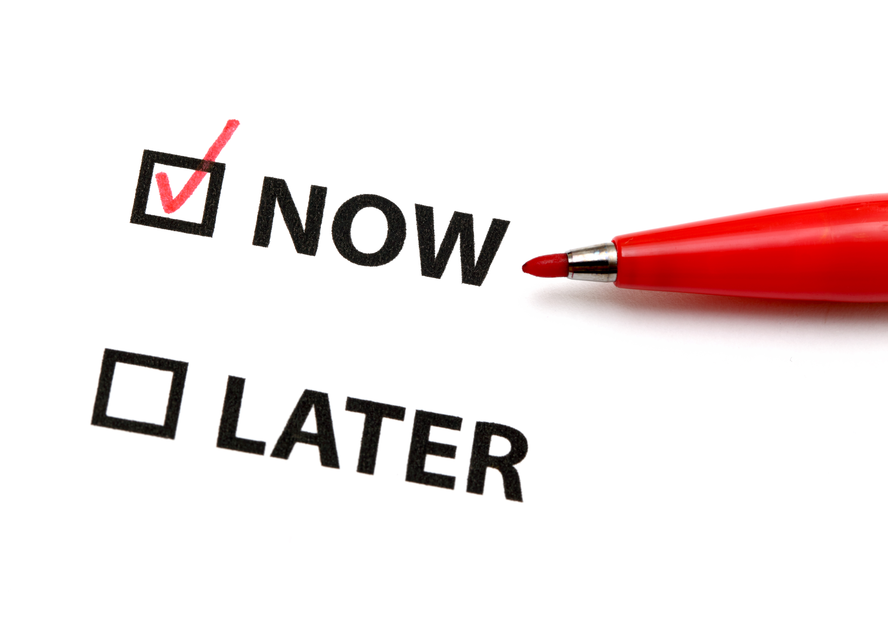
It’s time for you to act!
Endorse the UDPM, apply it and speak about it with your peers!
Help Make Mediation mainstream !
www.udpm.org
Notes:
It s time for you to act!
Endorse the UDPM, apply it and speak about it with your peers!
Go to www.udpm.org

Slide 14
Alliance of Mediators
for
Universal Disclosure
www.udpm.org
Notes:
Thank you

Slide 15
UDPM
Universal Disclosure Protocol for Mediation
Six elements to disclosure at the start of any mediation
Conflict of interest
Role of the Mediator and Parties
Confidentiality
Technology
General Process
Impact of Venue
delivering a global message to parties regarding what they can expect from Mediation, whatever their cultural, religious, legal, or national context.

